Slide 1
FACULTY OF ENGINEERING AND TECHNOLOGY DEPARTMENT OF COMPUTER ENGINEERING SOFTWARE ENGINEERING CEF440: Internet and Mobile Programming SYSTEM REQUIREMENTS FOR A DISASTER MANAGEMENT MOBILE APPLICATION

Slide 2
Presented By:
Group 2
NAMES | MATRICULE
QUINUEL TABOT NDIP-AGBOR | FE21A300
SIRRI THERESIA ANYE | FE21A306
NGONCHI RAMATOU YOLAND | FE21A260
CHE BLAISE NJI | FE21A157
LIMA CHARLES | FE21A225
Course Instructor:
Dr. NKEMENI Valery, PhD

Slide 3
Outline
01
02
03
Introduction
System Requirements
Conclusion
Functional
Non Functional
Business
Technical
Stakeholders and Users

Slide 4
Introduction
In today's world, natural disasters and emergencies are a constant threat. To effectively manage these situations, we need robust disaster management systems. This project proposes a solution: a Mobile-Based Disaster Management System.

Slide 5
Expected Outcomes
This project aims to leverage the power of mobile technology by empowering users with:
• Real-time alerts for impending disasters and evacuation orders.
• The ability to report incidents and request assistance directly through the app.
• Access to emergency resources and communication channels with authorities and other stakeholders during crises.

Slide 6
System Requirements
System requirements define the characteristics and functionalities a disaster management mobile application must possess to meet its objectives. These requirements can be categorized into different types:
DISASTER
MANAGEMENT

Slide 7
Real-time Alerts and Notifications
FUNCTIONAL REQUIREMENTS
These define the specific actions the application should be able to perform. For Our application, they include:
Incident Reporting and Assistance
Geospatial Data and Mapping Services

Slide 8
Community Engagement and Collaboration:
Preparedness and Mitigation Resources:
Emergency Contacts and Services:

Slide 9
NON-FUNCTIONAL REQUIREMENTS
Authentication and Authorization:
Real-time Delivery of Alerts and Notifications:

Slide 10
Accuracy and Reliability of Geospatial Data:
Accessibility of the Application:

Slide 11
BUSINESS REQUIREMENTS
Streamlined Coordination Between Emergency Responders
Information Sharing Among Users and Stakeholders
Centralized Repository of Emergency Contact Information

Slide 12



TECHNICAL REQUIREMENTS
Tools Required
UI Design ( Figma) : Besides the fact that it is really good and gets the job done, it is very easy to use, free and all team members have some minimum amount of experience with it
Mobile Application UI (React Native) : RN has a low barrier of entry so it is quite easy to pick up by someone with some Javascript or React knowledge no matter how basic.
Styling UI ( SaSS and NativeWind): SaSS is a flavour of CSS while NativeWind is in simple terms, custom tailwind css but for RN

Slide 13



Database (MySQL / MongoDB): The entire team has been working with MSQL right from the start of our program at FET so we are fairly good with it.
Backend Language/Framework (Typescript/NestJs): NestJs is a NodeJs framework for building performant and scalable backend applications(APIS).
Deployment Backend (Azure Container Apps): We intend to host the final backend as an Azure Container application. This means we’ll have to build the app as a docker container in the end before deployment.
Documentation: This application will be documented with the help of Swagger documentation with the direction of the OpenApi specification

Slide 14
STAKEHOLDERS AND USER REQUIREMENTS
STAKEHOLDERS
Government Agencies
Non-Profit Organizations
Emergency Responders (Fire Department/ Police)
Users (General Public)

Slide 15
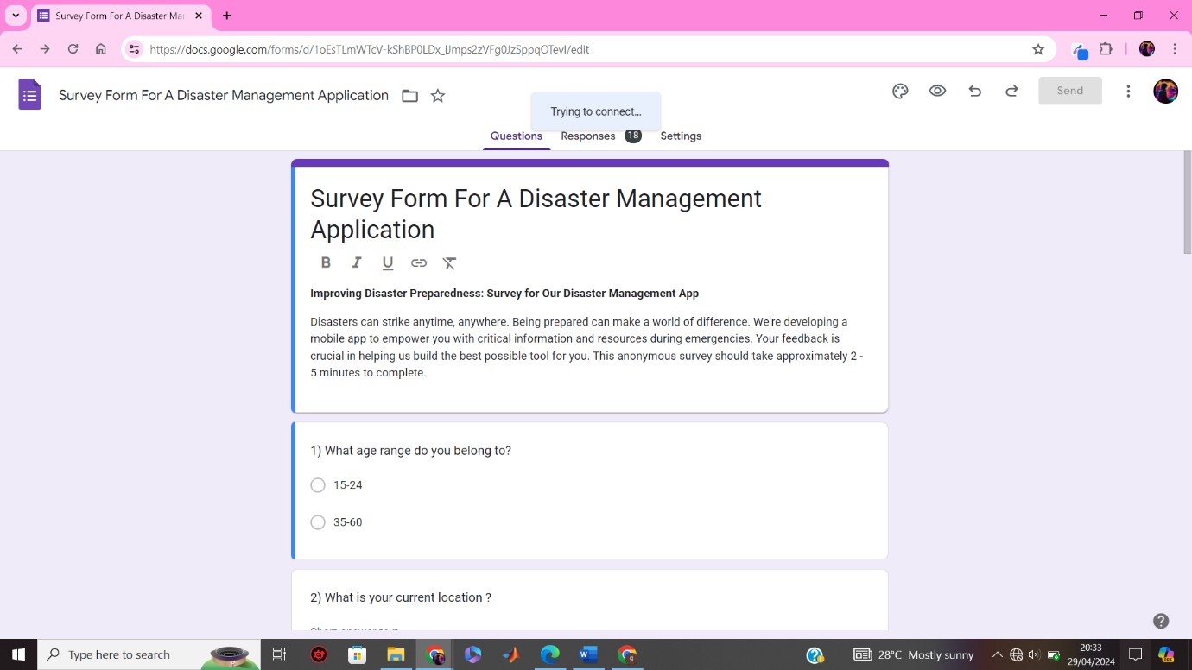
Requirement Gathering
Survey

Slide 16
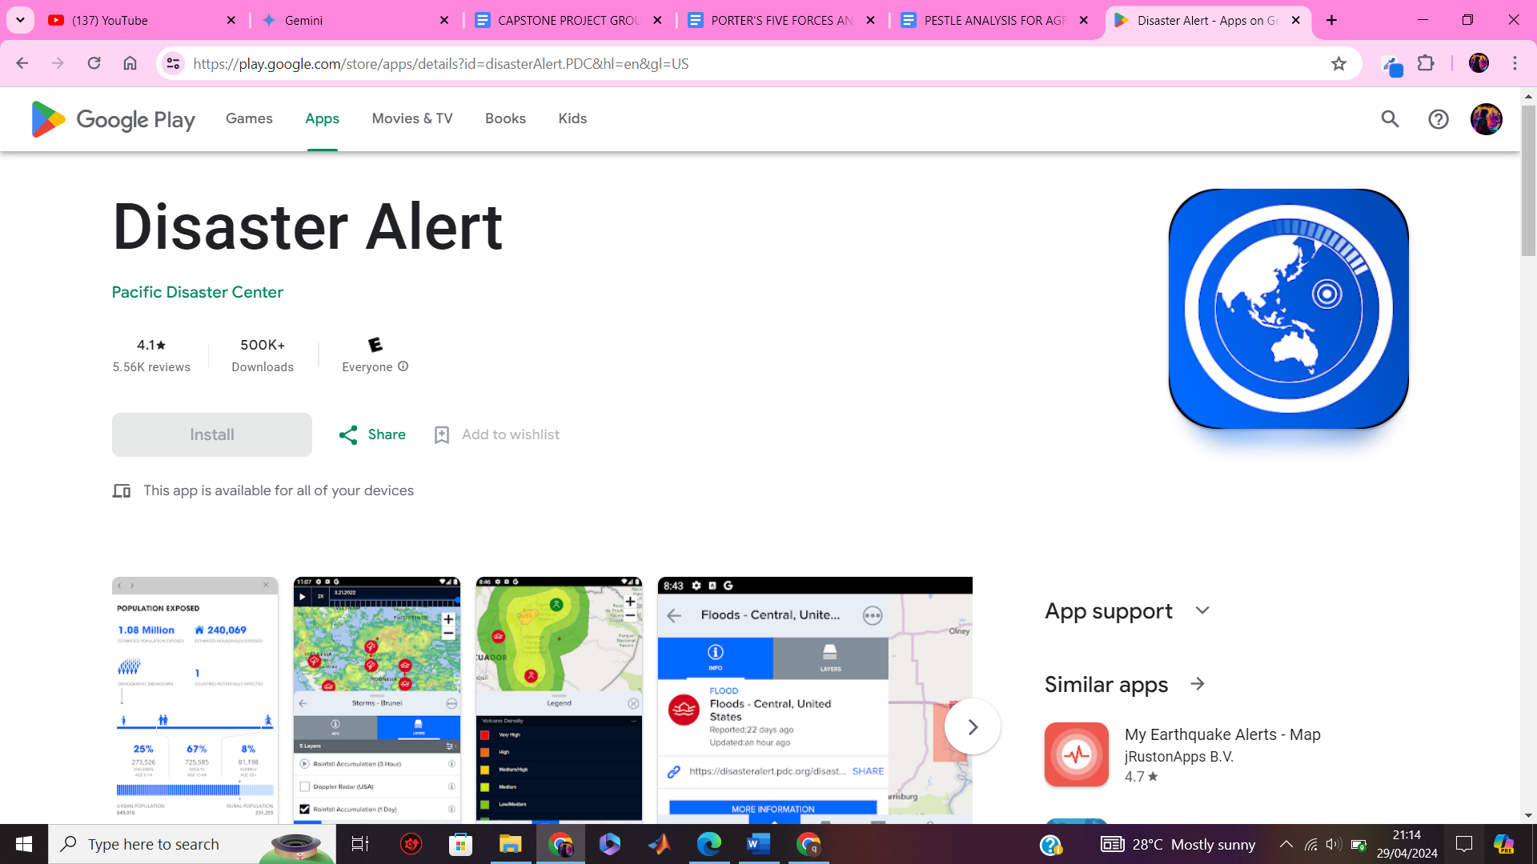
Research

Slide 17
Conclusion
The proposed system leverages the power of mobile technology to create a comprehensive platform for all stages of disaster management: preparedness, response, and recovery. The mobile application will equip users with real-time alerts, incident reporting capabilities, access to emergency resources, and communication channels with authorities and other stakeholders during crises.

Slide 18
Thank You
For Your
Keen Attention
Disaster
Management

